Slide 1
Recognizing Reader’s Affect Using EEG Data
Researcher: Kristine Kalaw
Adviser: Ms. Ethel Ong

Slide 2
Outline of the Presentation
Overview of the Current State of Technology
Emotions (Affect)
Affective Computing
Emotion Detection and Recognition
Reading Fiction
Research Problem
Objectives / Scope and Limitations
Research Significance

Slide 3
Overview of the Current State of Technology

Slide 4
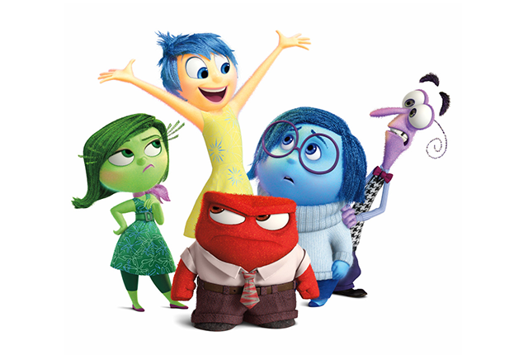
Emotion Theory
Emotions or affect play vital roles in rational and intelligent behavior such as cognition and decision making.
© Walt Disney Pictures / Pixar Animation Studios / Inside Out (2015)

Slide 5
Emotional Intelligence
Emotional Intelligence is a subset of social intelligence that involves the ability to monitor one's own and others' feelings and emotions, to discriminate among them and to use this information to guide one's thinking and actions.
EI
Social Awareness
Relationship Management
Self Management
Self-Awareness

Slide 6
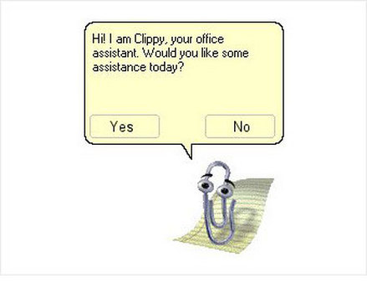
Affective Computing
Affective computing is computing that relates to, arises from, or influences emotions.
Perceive emotions
Express emotions
Perceive and express emotions
© Microsoft / Microsoft Office 97-2000 / Office Assistant

Slide 7
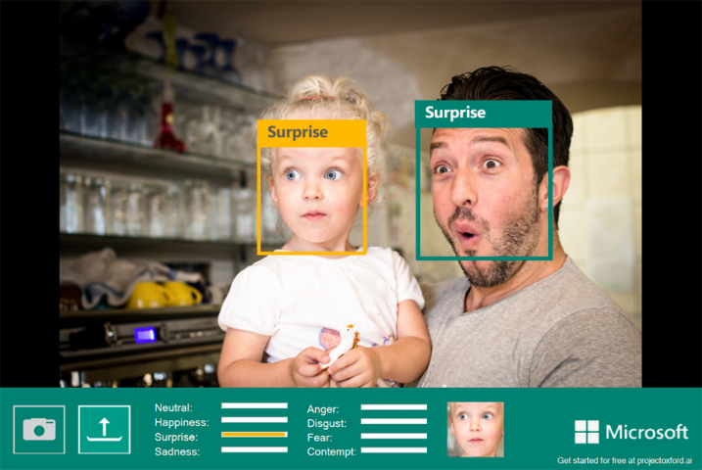
Emotion Detection and Recognition
Humans naturally read many physiological signals of emotions
Facial expressions
Vocal expressions
Skin conductance
Heart rate
© Microsoft / Project Oxford

Slide 8
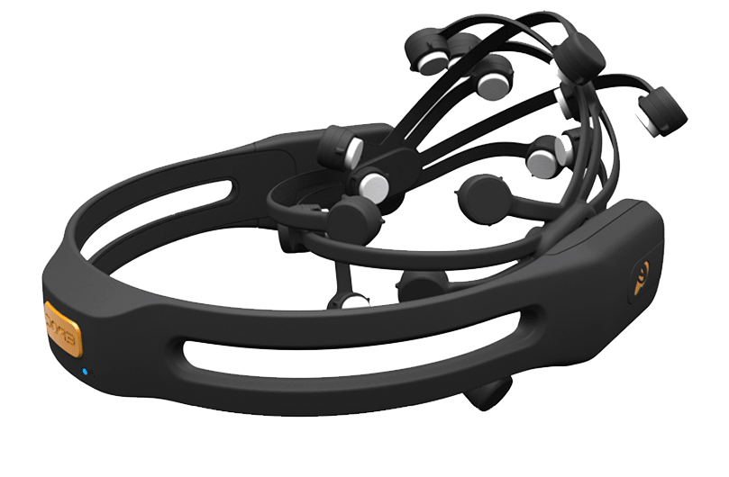
Electroencephalography
EEG is the recording of the brain's electrical activity and represents a way to look at the brain functions in real time.
© Emotiv

Slide 9

Reading Fiction
Reading is an experience that is never the same from one reading to the next. To read non-fiction is to be informed; to read fiction is to be moved.
© Scholastic Corporation / J.K. Rowling / Harry Potter (1997-2007)

Slide 10
There is no current work that has studied brainwave patterns and their association to affect while a person is reading literary fiction.
Research Problem

Slide 11
Objectives / Scope and Limitations

Slide 12
To build an affect model that associates the EEG signals collected from readers (while they are reading stories) to specific emotions.
General Objective

Slide 13
Specific Objective #1
Objective
Scope and Limitation
To review the approaches, methodologies, and experiments of existing affect detection or recognition studies that uses EEG data;
A review of existing affect detection or recognition studies that uses EEG data.

Slide 14
Specific Objective #2
Objective
Scope and Limitation
To identify the different emotions the can be elicited from the readers by the stories;
A review of different emotion models and determine which of them is appropriate for reader affect.

Slide 15
Specific Objective #3
Objective
Scope and Limitation
To build a corpus of EEG signals;
The participants will be people of ages between 18 to 25
They will read pre-selected short stories while an EEG sensor is attached to them
The set-up of Miall and Kuiken (1994) will be used as basis

Slide 16
Specific Objective #4
Objective
Scope and Limitation
To determine which elements of a story affects the reader's emotional state;
The study will attempt to determine which element of the story triggered the reader to evoke that emotion.
character traits and behavior
reader's empathy to the character
the story plot or casual chain of story events
lexical choices and sentence structure.

Slide 17
Specific Objective #5
Objective
Scope and Limitation
To implement supervised and unsupervised machine learning algorithms for classifying the emotion based on the EEG signals;
A review of related literature to identify unsupervised or supervised classification techniques best suited for the data

Slide 18
Specific Objective #6
Objective
Scope and Limitation
To define evaluation metrics for assessing the performance of the model;
Precision
Recall
F-measure

Slide 19
Research Significance

Slide 20
Affective Computing
Affective Computing
Wearable computing
Computer Vision
Pattern Recognition
Machine Learning
Digital Signal Processing
Human-Computer Interaction
Explore the feasibility and application of these existing areas on an unexplored domain.

Slide 21
Methodology and Experiments
Data Collection
Data Preparation
Pre-processing
Classification
Serve as basis and reference for related future studies.

Slide 22
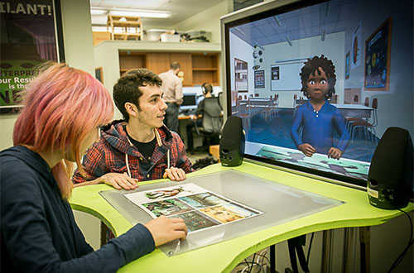
Affect-Related Systems
Results of this study can be further utilized in intelligent tutoring systems (ITS) or embodied conversational agents (ECA).
© ArticuLab / Carnegie Mellon University / Project Alex

Slide 23

Beyond Computer Science…
The findings of this work may be informative to affective science, psychology, and other related fields.
© Open University

Slide 24
Thank you for listening! ☺
kristine_ma_kalaw@dlsu.edu.ph

